Slide 1
Community Impact Business Case Competition
Case Masters

Slide 2




Meet the team
Mona Duvvapu
Rahul
Kunku
Archita Ray
Pooja
Kannuri
Vishnu
Ponduri

Slide 3
Agenda
Problem Statement
Success Stories
Challenges
About the Organisation
Leveraging Organisation Strengths
Greater Lafayette Demographics
Strategies to boost affordability
Other Key Factors
Role of Analytics
Conclusion

Slide 4
Problem Statement
Objective
To innovate a sustainable model for affordable housing in Greater Lafayette through a strategic alliance between Homestead CS and Habitat for Humanity
Challenge
Integrate national affordable housing strategies with local insights to create a tailored, impactful response. Anticipate and navigate through potential challenges and stages of project implementation
Community Engagement
Develop a community engagement blueprint that aligns with national models yet is customized for local resonance and support in Greater Lafayette

Slide 5
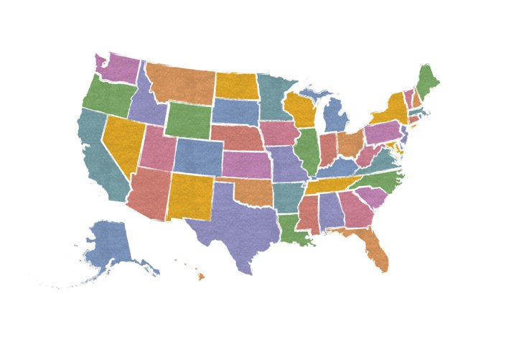
Success stories
LAFAYETTE, COLORADO
Provide incentives to developers building houses for the community or have them pay fees instead
WASHINGTON HB 1110 Bill:
Builders are encouraged to build duplexes, four-plexes, and six-plexes based on the population of the city
LAFAYETTE, COLORADO
Inclusionary Housing Policy
30% affordable units in new developments
10% permanent affordability for ≤80% area median income
20% initial affordability for 80-120% area median income

Slide 6

Hurdles in Prior Initiatives
Housing developments were situated on the outskirts, lacking proximity to transit options.
Residents prioritize local aesthetics, favoring house size harmony over affordability, feasibility, and environmental impact.
Falls short in addressing the larger issue addressed by HB 1110.

Slide 7
About the Organizations
Homestead CS
Habitat for Humanity
Non-Profit, HUD-Certified Housing Agency
Service Areas: Homebuyer Education, Foreclosure Prevention, Purchase Counseling, Reverse Mortgages
Educational Topics: Financial Literacy, Credit, Affordability, Mortgages, Real Estate Process
Home Repair Grants: Up to $7,500 for qualified repairs, income-based, forgivable over 5 years
Global nonprofit housing organization.
Education: Homeownership classes on financial/legal responsibilities
Sweat Equity: Homeowners contribute labor to home construction
Mortgages: Affordable, zero-interest home purchasing
Eligibility: Income requirements, willingness to contribute sweat equity, and maintain home

Slide 8


Leveraging organizations’ strengths
Resources
Talent
Outreach
Builders/Construction Workers
Volunteers
Technicians/Repairmen
Structural designers
Well connected network
Community partnership
Government connections
Financial institution ties
Notes:
Points to cover in this slide:
Resources we can use from both of these organizations to improvise existing housing situation and building new community centers

Slide 9







Greater Lafayette Demographics
Race and Ethnicity
Poverty
10.1%
< 10.7% Poverty rate of State of Indiana
78% White; 7% Asian; 5% Black; 4% Latino;
6% Other races
Occupation
Median Age
Management, sales, education, training, and library positions
30.4 years
< 37.3 years
Median age of State of Indiana
Education
Income
40.3% of adults have a bachelor’s degree or higher > 29.4% in State of Indiana
$54,490
> $52,969
Median household income of State of Indiana
Source: United States Census Bureau Link
Notes:
Greater Lafayette, Indiana is a metropolitan area that includes the cities of Lafayette and West Lafayette, as well as surrounding unincorporated areas. As of 2022, the population of Greater Lafayette was estimated to be 237,130
Housing: The homeownership rate in Greater Lafayette is 65.5%. This is slightly lower than the homeownership rate for the state of Indiana, which is 66.6%.

Slide 10
Strategies to boost affordability
Both organizations must collaborate with Greater Lafayette communities, developers, renters, and tenants to ensure future housing affordability.
Engage with local government to establish special policies and issue permits encouraging builders and developers to join renters' assistance programs.
Foster a supportive environment like town hall meetings and discussion forums aiming to address and alleviate housing affordability challenges in the future.
We’ll examine affordability strategies through these lenses:
Existing properties, which can be revamped to accommodate more people
New properties, where 20% of the houses can be built over unused spaces

Slide 11
Existing Properties
Retrofit and adapt existing buildings for increased density and mixed-use
Strategies/ Reforms | Implementation | Successful Implementations
Accessory Dwelling Units (ADUs) | Convert existing spaces, such as garages or basements, or by building new units on the property | Washington, DC: Approved accessory dwelling units in high-cost neighborhoods
Construction material | Identify economical options: Choose materials that reduce the cost and waste associated with traditional site-built homes | Forterra’s Forest to Home: Utilizing sustainable materials like Cross-Laminated Timber to lower construction costs​
Expedition of construction | Reducing the time and cost associated with real estate development | Santa Rosa, San Diego in California, and Austin, Texas, have streamlined permitting and review processes
Encourage sweat equity | By utilizing homeowner's own labor, such as painting or simple renovations, we can save on professional costs | Habitat for Humanity's global programs reduce costs by involving homeowners in building their homes
Reassess the affordability | By conducting surveys to learn about the consumers’ interests and their top 3 amenities required | Novel concept

Slide 12
New Properties
Innovative apartment building strategies
Strategies/ Reforms | Implementation | Successful Implementations
Utilisation of existing unused spaces | Former Industrial sites Vacant lots Underutilized commercial spaces, etc | The SugarCube, Dublin & HafenCity, Hamburg : Former industrial space transformed into affordable housing
Low-cost construction | Modular & pre-fab constructions Cost-effective building materials – wood Reduce labour | Nakagin Capsule Tower, Tokyo: World’s first plug-in architecture composed of 140 self-contained prefabricated concrete capsules
Developers/Builders Incentives | Tax incentives (LIHTC) Prioritize building permits for partnered developers | San Francisco: increased density allowances, in exchange for incorporating affordable housing units in their projects.
Zoning Reforms | Jurisdictions can permit multi-family housing in single-family zoned areas Promote developers to reserve a portion of the housing for below-market rates through inclusionary zoning. | Minneapolis: Eliminated single-family zoning to increase supply and density
Go Tall not Wide | Encourage builders to construct duplexes, four-plexes, and six-plexes over independent houses and provide amenity centres. | Dar Lamane (Morocco) project built affordable apartments housing 25,000 residents.

Slide 13
Other Key Factors
Walkability Factor
Permits from local jurisdiction
Infrastructure to withstand additional units i.e, MEP (Mechanical – Electrical - Plumbing)
Units to be built based on area demographics

Slide 14
How Analytics can help
Stage of construction | Actual Costs (USD) | Costs After Savings (USD) | Percentage Saved (%) | Analytical procedures | Examples
Design and Planning | 600,000 | 540,000 | 10% | Optimization, Layout Efficiency Analysis | Utilizing publicly available housing data to optimize floor plans.
Pre-construction | 1,300,000 | 1,100,000 | 15% | Recycling & Material Efficiency Analysis, Waste Management Optimization, Labor Management | Analyzing historical data to optimize purchasing of lumber.
Core Construction | 1,800,000 | 1,460,000 | 19% | Energy Usage Modeling, Material Planning, R-value Optimization, Material Usage Analysis | Comparing insulation materials for cost and efficiency, to enable energy-efficient home designs.
Finishing | 4,100,000 | 3,700,000 | 10% | Durability vs. Cost Analysis, Layout Optimization, Market Price Trend Analysis, Maintenance Analysis | Analyzing volunteer labor efficiency to schedule better and track prices to buy appliances during discounts.
External Works and Miscellaneous | 2,200,000 | 1,800,000 | 18% | Climate Adaptation, Irrigation Efficiency, Risk Analysis, Contingency Allocation | Using local data & risk software to assess potential overruns and allocate budget accordingly
Total | 10,000,000 | 8,600,000 | 14% | Estimated at a rate of $20,000 per house for 500 houses

Slide 15
Conclusion
Affordability is inclusive of the existing housing scenario and to-be-built houses.
Making existing housing scenario an improvised habitat:
Matching resident’s preferences to the segments of the area with their preferred amenities and facilities
Draw inspiration from the successful models already implemented
Encourage sweat equity
New houses to create a new habitat:
Zoning Reforms
Go Tall Not Wide
Utilize the resources of Habitat for Humanity and Homestead CS to expediate the process of creating a new habitat

Slide 16
Thank You

